Slide 1
Sentiment Analysis
Final Semester project
FA18-BCS-002 Abdul Hameed Khan
FA18-BCS-010 Daud Ahmed
Supervisor:
Ma’am Ayesha Jadoon

Slide 2
What is sentiment Analysis?
Sentiments are feelings, opinions, emotions, likes/dislikes, good/bad
Sentiment Analysis is a Natural Language Processing and Information Extraction task that aims to obtain writer’s feelings expressed in positive or negative comments, questions and requests, by analyzing a large numbers of documents.
Sentiment Analysis is also known as Opinion Mining.
Sentiment Analysis is a study of human behavior in which we extract user opinion and emotion from plain text.

Slide 3
What is sentiment analysis contd.
It identifies the opinion or attitude that a person has towards a topic or an object.
It is a task of identifying whether the opinion expressed in a text is positive or negative.
Automatically extracting opinions, emotions and sentiments in text.

Slide 4
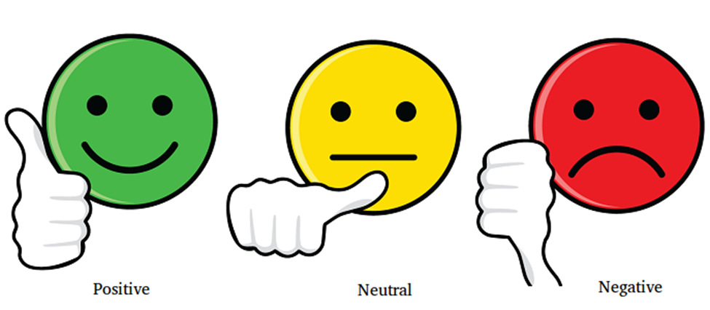
Example
User’s Opinions :
Ahmed : It’s a great movie (Positive statement)
Amina : Nah!! I didn’t like it at all (Negative statement)
Akbar : The new iOS7 is awesome..!!!(Positive statement)
Polarity :
Positive
Negative
Neutral

Slide 5
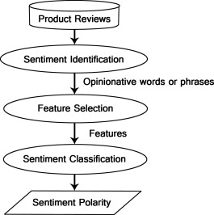
Sentiment analysis diagram:

Slide 6
Problem statement
Application on the play store or app store then he needs to check all the comments/reviews that he received on his application.
No application for this problem on the Play Store and App store for giving us sentiment about our application.
Manually check all the reviews.
Impossible for a human to do sentiment of applications.

Slide 7
Problem Solution
Sentiment analysis can solve this problem.
The sentiment analysis uses machine learning and Natural language processing (NLP).
Analyze majority of reviews or comments and provide better results for this task.

Slide 8
Advantages/Benefits of Proposed System
Upselling opportunities
Agent monitoring
Training chatbots
Identifying key emotional triggers
Handling multiple customers
Adaptive customer service
Identify a dissatisfied customer
Customer Satisfaction

Slide 9
Interdependencies
Sentiment analysis depends on the reviews, reviews depend upon the users of the product.
Users depend upon the product
Product depends upon the organization or developer
Organization is independent.

Slide 10
Software Process Methodology
We will use Machine learning and Natural Language Processing (NLP) to classify sentiments on reviews of the app.
We need a dataset to make our ML model.
Train the data set on this model.
If the accuracy is satisfying then we will use it further but if the accuracy is not satisfying then we will train it again.
Repeat until we get high accuracy.

Slide 11
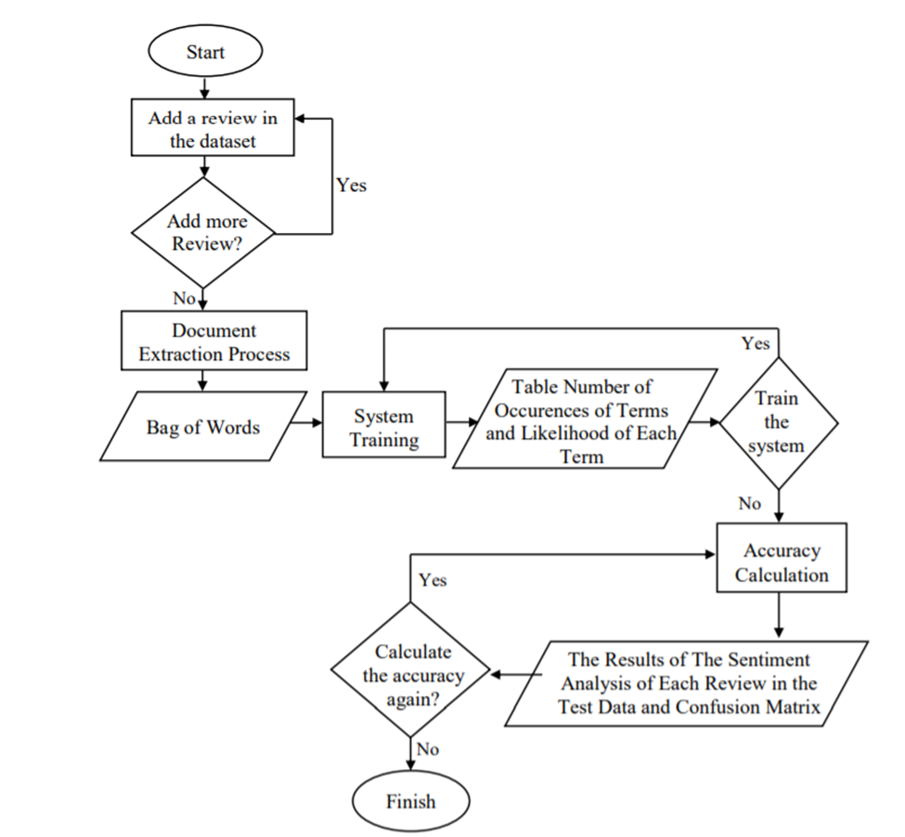
FLOWCHART OF SENTIMENT ANALYSIS

Slide 12
SVM (Support Vector Machine)
Supervised machine learning algorithm.
Used for either classification or regression.

Slide 13
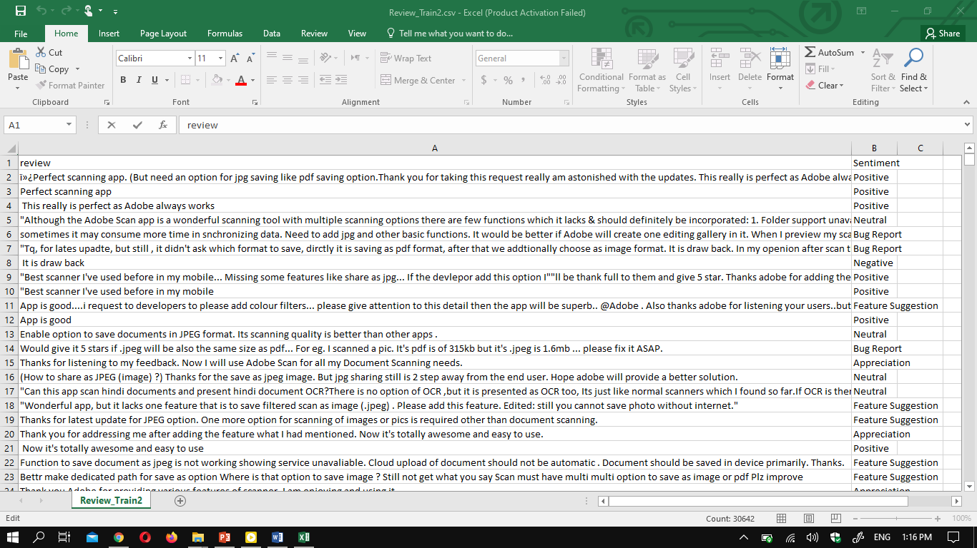
Dataset

Slide 14
Results
Our dataset contains more than 30000 reviews of different apps
We divided our dataset to train and test our model
Training accuracy of our model= 99%
Testing accuracy of our model= 95%

Slide 15
Conclusion
Nowadays, sentiment analysis or opinion mining is a hot topic in machine learning.
show the basic way of classifying reviews into positive or negative category
we are focusing on general sentiment analysis.

